Slide 1
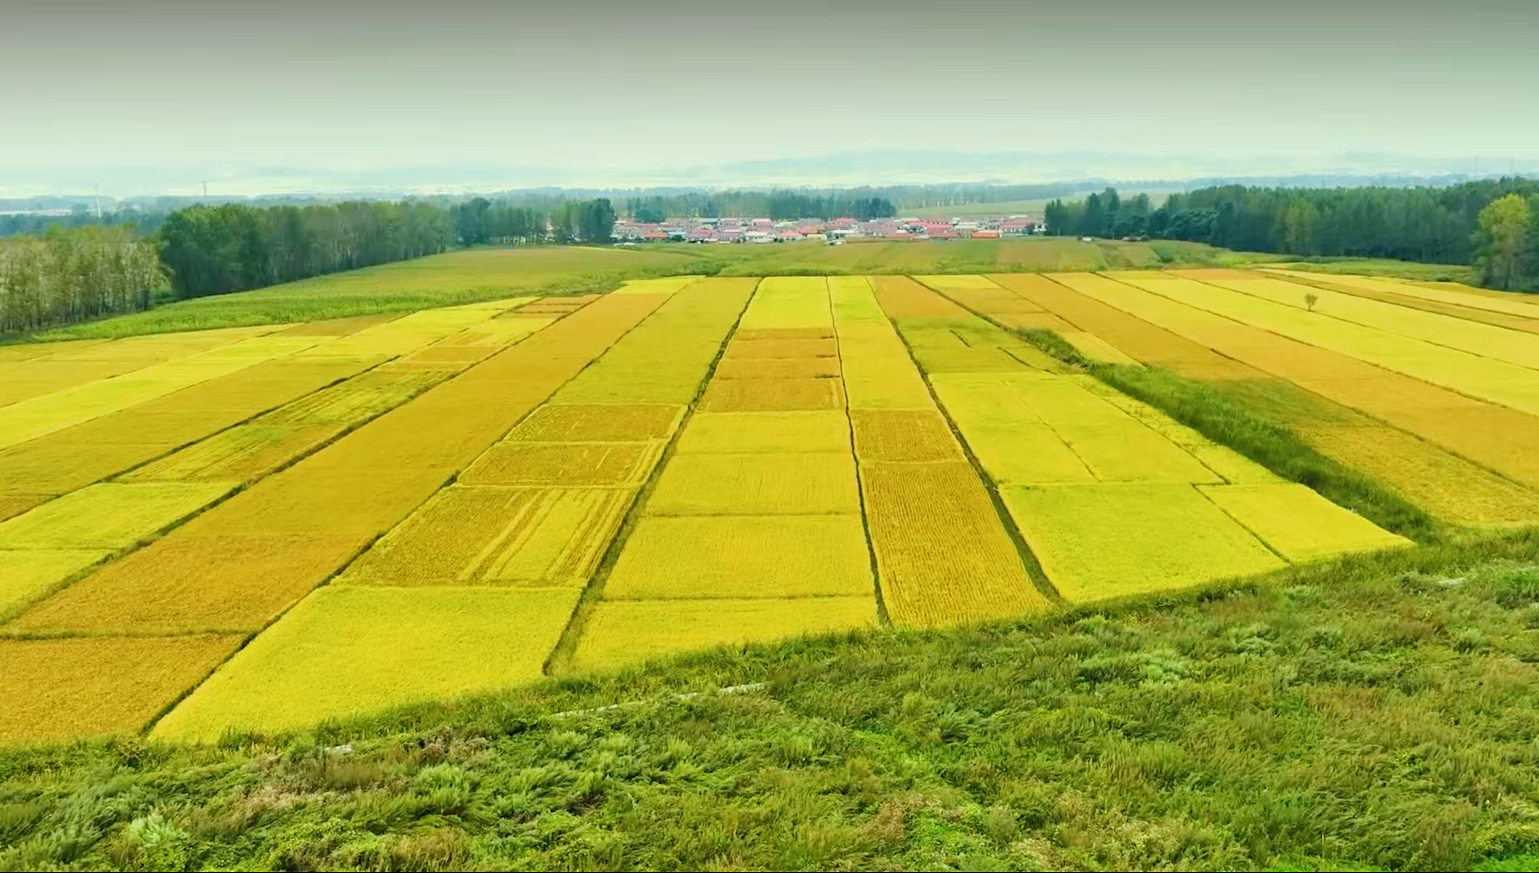
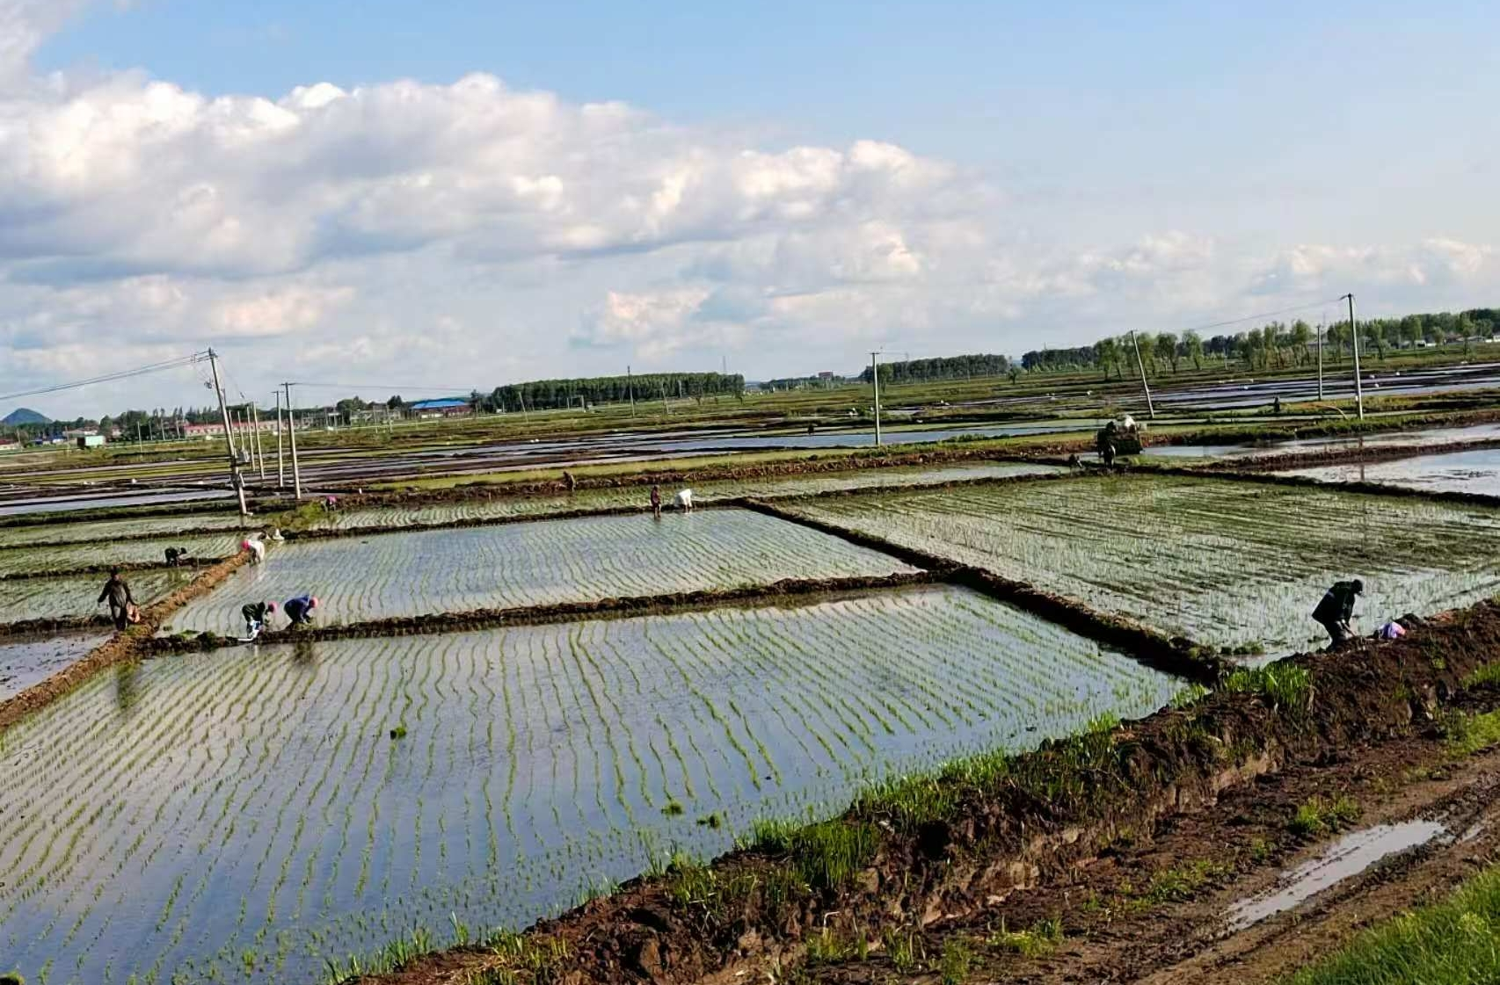
吉林省长春市朝阳区乐山镇辛屯村探索推进“小田并大田”土地集约经营模式

Slide 2
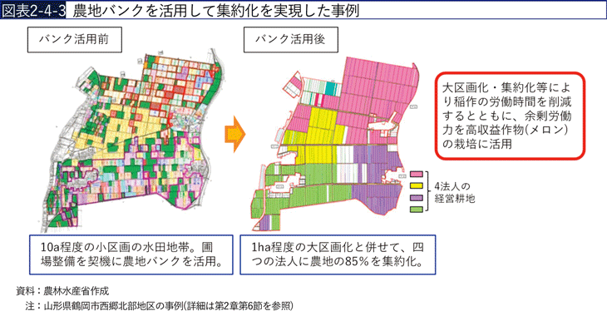
https://www.maff.go.jp/j/wpaper/w_maff/r3/r3_h/trend/part1/chap3/c3_4_00.html

Slide 3
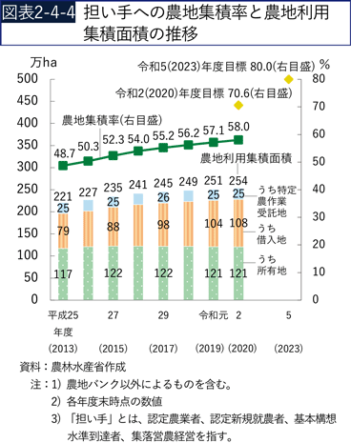
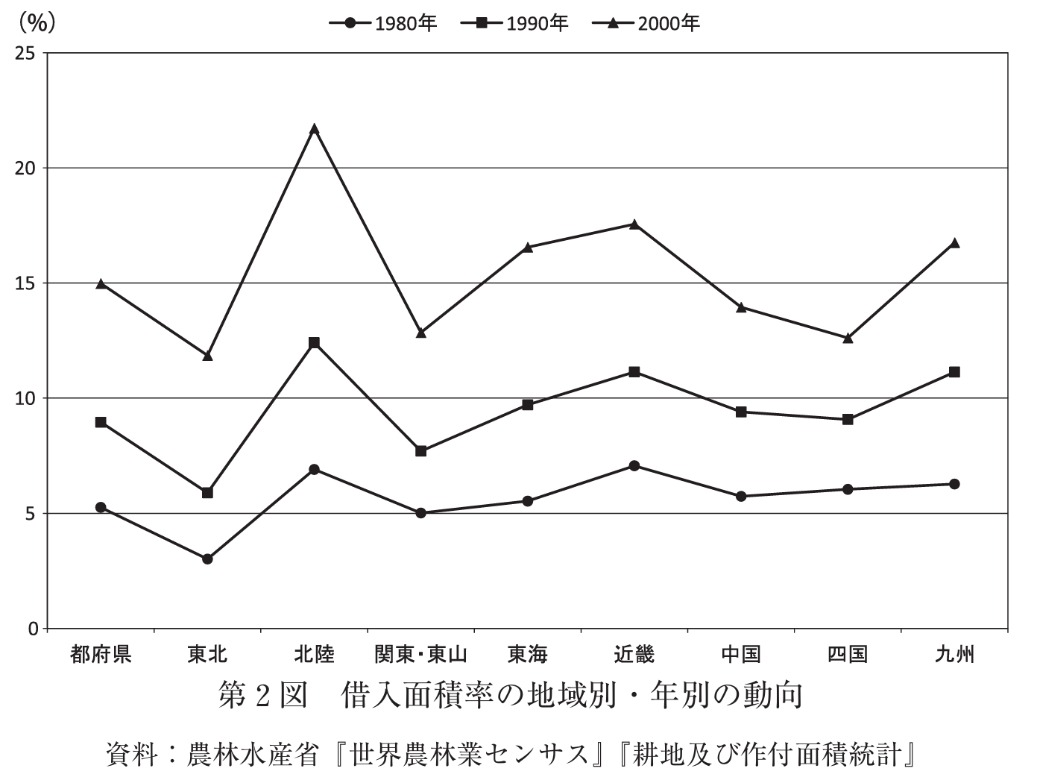
担い手への農地利用集積面積は、農地バンクを創設した平成26（2014）年度以降、年々増加しており、令和2（2020）年度末時点で254万haとなりました。借入地の面積が増加傾向にあり、同年度末時点で108万haと全体の4割を占めています。
自2014财年农田银行成立以来，农田使用面积逐年增加，截至2020财年末已达到254万公顷。 借用土地面积正在增加，截至同财年末，占总面积的40%，达到108万公顷。
https://www.maff.go.jp/j/wpaper/w_maff/r3/r3_h/trend/part1/chap3/c3_4_00.html

Slide 4
推荐理由：
Research question:
Hypotheses / 仮説:法人化率が高い市町村では，農地の流動化が促進されると予想する．

Slide 5
農地流動化や農地集積に関しての実証研究
Author (year) | Data | Independent variable | Dependent variable
高橋（2010） Takahashi (2010) | 都道府県 prefecture-level data | 取引費用 transaction costs | 農地貸借 farmland rental
Ito et al.（2016） | 都道府県 prefecture-level data | 農地貸借率 farmland rental rates | 耕作放棄地率 abandoned farmland rates
藤栄（2016） Fujie (2016) | 個票・集落営農 Individual-level ＆ community-level data | 認定農業者制度や法人化 certified farmer system and incorporation | 農地集積 farmland consolidation
高山（2015） Takayama (2015) | 北海道の集落 Hokkaido community-level data | 農地保有合理化法人設立 establishment of farmland rationalization corporations | 農地流動化 farmland mobility
武川（2019） Takekawa (2019) | 京都府の集落 Kyoto community-level data | 整備事業 improvement projects in communities | 農地流動化 farmland mobility
徳村実央子（2025） Tokumura (2025) | 市町村 municipal-level data | 農業経営体の法人化 incorporation of agricultural management entities | 農地賃借 farmland rental

Slide 6
Variable Type / 変数種別 | Variable Name / 変数名 | Definition / 定義 | Mean / 平均 | SD / 標準偏差
Dependent Variable / 目的変数 | Rental area rate / 借入面積率 | Area of rented farmland / total farmland area of farming entities with managed farmland / 借入している耕地面積/経営耕地のある実農業経営体の耕地面積 | 0.33 | 0.18
Explanatory Variable / 説明変数 | Incorporation rate / 法人化率 | Number of incorporated entities / total number of farming entities / 法人化している経営体数/全農業経営体数 | 0.02 | 0.02
 | Village meeting holding rate / 寄り合いの開催率 | Number of communities holding meetings / total communities / 寄り合いを開催している集落数/全集落数 | 0.93 | 0.12
 | Farmland conservation rate / 農地保全率 | Number of communities conserving farmland / total communities / 農地を保全している集落数/全集落数 | 0.40 | 0.30
 | Total managed farmland area / 経営耕地総面積 | Log of total farmland area (a) managed by farming entities / 農業経営体が経営している総耕地面積（a）の対数値 | 10.71 | 1.45
 | Proportion of communities within 30 min of DID / DIDまで30分以内の集落の割合 | Number of communities within 30 minutes of DID / total communities / DIDまでの所要時間が30分以内の集落数/全集落数 | 0.73 | 0.38
 | Proportion with rice as top sales item / 稲作が販売金額1位である割合 | Number of entities with rice as top selling crop / total farming entities / 稲作が農作物販売金額1位である経営体数/全農業経営体数 | 0.46 | 0.28
 | Average age / 平均年齢 | Average age of farm workers in individual management entities / 個人経営体の農業従事者の平均年齢 | 60.74 | 2.92
 | Successor securing rate / 後継者の確保率 | Number of commercial farms with a successor 5 years prior / total commercial farms / 5年前に後継者がいた販売農家数/全販売農家数 | 0.56 | 0.13
集落機能
地域特性
経営体の特性

Slide 7
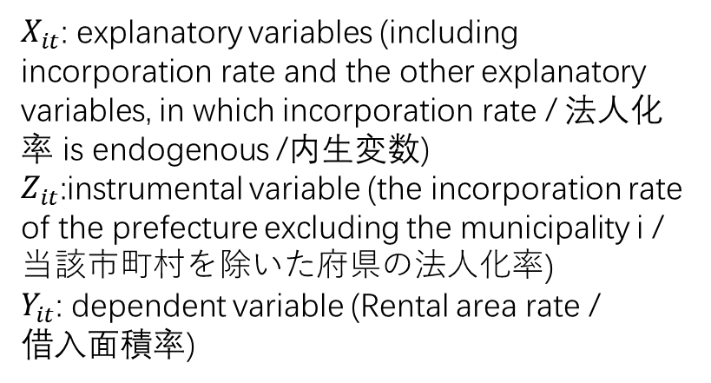
First Stage (Instrumental Variable Regression)
First Stage (Instrumental Variable Regression)
$$I_{it}=α_{0}+α_{1}Z_{it}+α_{2}X_{it}+α_{i}+α_{t}+ε_{it}$$
$$I_{it}=α_{0}+α_{1}Z_{it}+α_{2}X_{it}+α_{i}+α_{t}+ε_{it}$$
Second Stage (Two-Stage Least Squares)
Second Stage (Control Function Approach)
$$Y_{it}=β_{0}+β_{1}\hat{I_{it}}+β_{2}X_{it}+β_{i}+β_{t}+ν_{it}$$
$$Y_{it}=β_{0}+β_{1}I_{it}+β_{2}X_{it}+β_{3}\hat{ε_{it}}+β_{i}+β_{t}+ν_{it}$$
$$I_{it}=\hat{I_{it}}+\hat{ε_{it}}$$
$X_{it}$: explanatory variables (including incorporation rate and the other explanatory variables, in which incorporation rate / 法人化率 is endogenous /内生変数)
$Z_{it}$:instrumental variable (the incorporation rate of the prefecture excluding the municipality i /当該市町村を除いた府県の法人化率)
$Y_{it}$: dependent variable (Rental area rate /
借入面積率)
An instrumental variable must satisfy two key conditions:
Relevance, meaning that the instrument is sufficiently correlated with the endogenous variable, which is supported by the first-stage regression results; and
Exogeneity, meaning that the instrument is uncorrelated with the error term in the structural equation.
Notes:
The first stage estimates the endogenous variable using instruments, while the second stage includes the residual to test for endogeneity.
The 2SLS and control function approaches are numerically equivalent in linear models. The key difference lies in implementation: 2SLS replaces the endogenous variable with its predicted value, while CFA directly controls for endogeneity by including the first-stage residual. An advantage of CFA is that it provides a convenient test for endogeneity through the significance of the residual term.
Although the control function approach appears more intuitive due to its ability to directly test endogeneity, it is not inherently superior to 2SLS in linear models. The two methods are numerically equivalent under correct specification. However, 2SLS remains the standard approach in empirical research due to its stronger theoretical foundation, broader applicability, and well-developed diagnostic tools, especially in handling weak instruments. The control function approach becomes particularly valuable in nonlinear models, where 2SLS is not applicable.

Slide 8
Variable / 変数 | （Ⅰ）1st Stage: Incorporation Rate / 第1段階 法人化率 |  | （Ⅱ）2nd Stage: Rental Area Rate / 第2段階 借入面積率 |  | （Ⅲ）OLS
 | Coef. / 係数 | SE / 標準誤差 | Coef. / 係数 | SE / 標準誤差 | Coef. / 係数 | SE / 標準誤差
Incorporation rate / 法人化率 |  |  | 2.542*** | 0.441 | 0.592*** | 0.100
Prefecture-level incorporation rate / 府県の法人化率 | 0.878*** | 0.115
Meeting holding rate / 寄り合いの開催率 | −0.005 | 0.005 | −0.006 | 0.026 | −0.020 | 0.017
Farmland conservation rate / 農地保全率 | −0.001 | 0.002 | 0.003 | 0.010 | 0.007 | 0.010
Total managed farmland area / 経営耕地総面積 | 0.005 | 0.005 | 0.132*** | 0.023 | 0.144*** | 0.008
Communities within 30 min of DID / DIDまで30分以内の集落の割合 | 0.004* | 0.002 | −0.009 | 0.014 | −0.001 | 0.010
Proportion with rice as top sales / 稲作が販売金額1位である割合 | −0.012 | 0.009 | −0.153*** | 0.059 | −0.181*** | 0.028
Average age / 平均年齢 | −0.001 | 0.001 | 0.003 | 0.002 | 0.001 | 0.001
Successor securing rate / 後継者の確保率 | −0.198*** | 0.075 | −0.029 | 0.023 | −0.065*** | 0.019
Residual / 残差 |  |  | −2.040*** | 0.524
Sample size / サンプル数 | 3120 |  | 3120 |  | 3120
Adj. R² / 調整済み決定係数 | 0.658 |  | 0.902 |  | 0.902

